Slide 1


Indian Economy Data Analysis

Slide 2

Topic: Data Analysis on Indian Economy
FACULTY MENTOR:Prof. Nirmala Balasundaram
MEMBER:
Devi Priya.G(E0320016)
Darshitha(E0320043)
Priya Darshini(E0320026)
Varsha. A(E0320029)

Slide 3

Data Visualization
Data visualization is the graphical representation of the information and data.
By using visual elements like chart, graphs and maps, data visualisation tools provide an accessible way to see and understand trends, outliers and patterns in data.

Slide 4
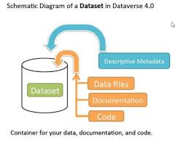
Data Set
A data set is a collection of data usually presented in tabular form.
Each column represents a particular variable. Each row corresponds to a given member of the data set in a question.
It lists values for each of the variables, such as height and weight of an object.
Each value is known as a datum.

Slide 5
DATA SET SOURCE: https://dbie.rbi.org.in/DBIE/dbie.rbi?site=home YEAR: 2015-2020
TOPICS:
*GDP
*Foreign exchange
*Exchange rate
*CPI

Slide 6
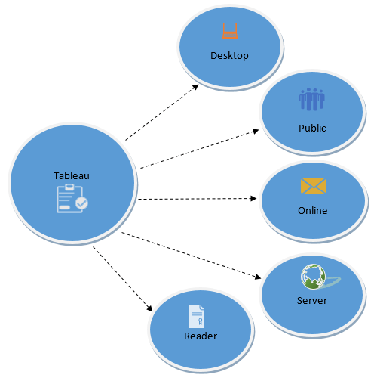
Tableau
Tableau is a powerful and fastest growing data visualization tool used in the Business Intelligence Industry.
It helps in simplifying raw data into the very easily understandable format.
Data analysis is very fast with Tableau and the visualizations created are in the form of dashboards and worksheets
The best feature Tableau are
Data Blending
Real time analysis
Collaboration of data.

Slide 7
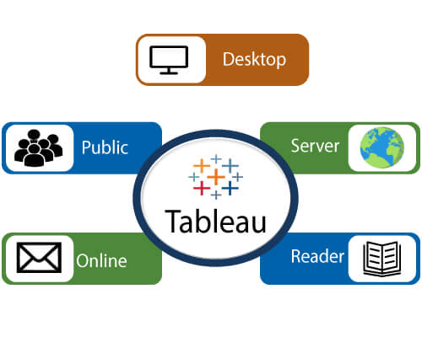
Tools in Tableau
Tableau desktop
Tableau public
Tableau server
Tableau online
Tableau reader

Slide 8
AIM OF THE PROJECT
The aim of this project is to know about Indian Economy and get a detailed view on various aspects that affect the Indian Economy during the period 2015-2020.

Slide 9
FINDINGS..
Which service has contributed maximum to the GDP over the last 5 years?
What the avg. turnover in terms of GDP over the last 5 years and which year contributed the most?
Which year had the maximum foreign exchange reserve?
Which year had the major impact on the exchange of Indian goods?
Which month had let to the drastic increase in inflation over the commodities?

Slide 10
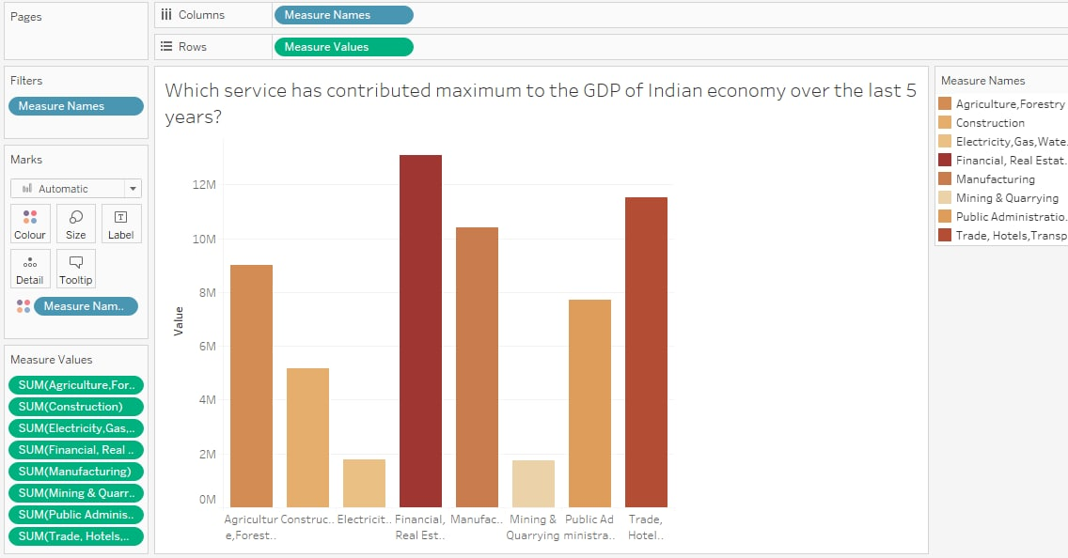

Slide 11
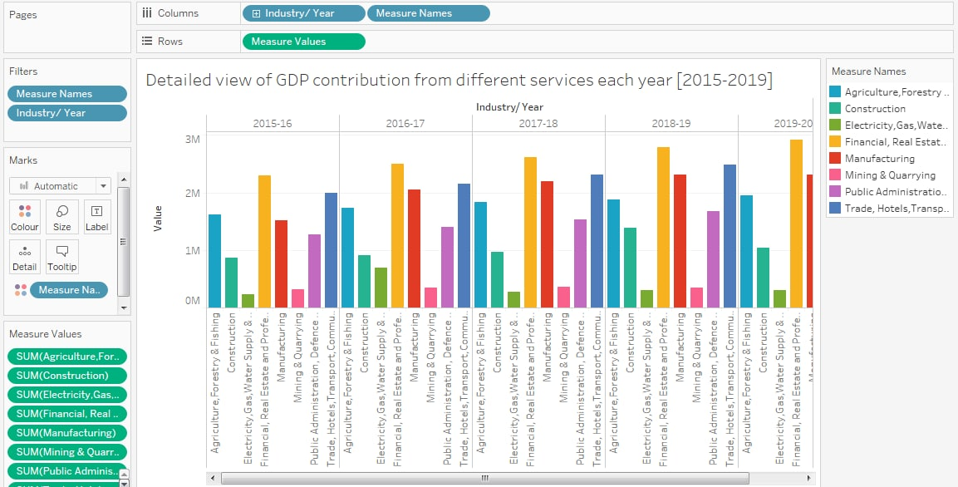

Slide 12
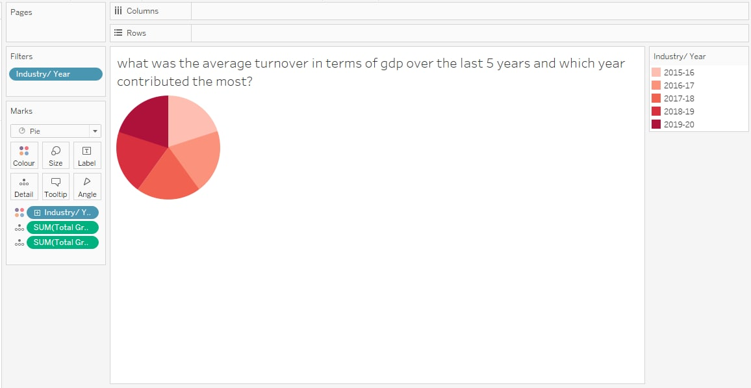

Slide 13
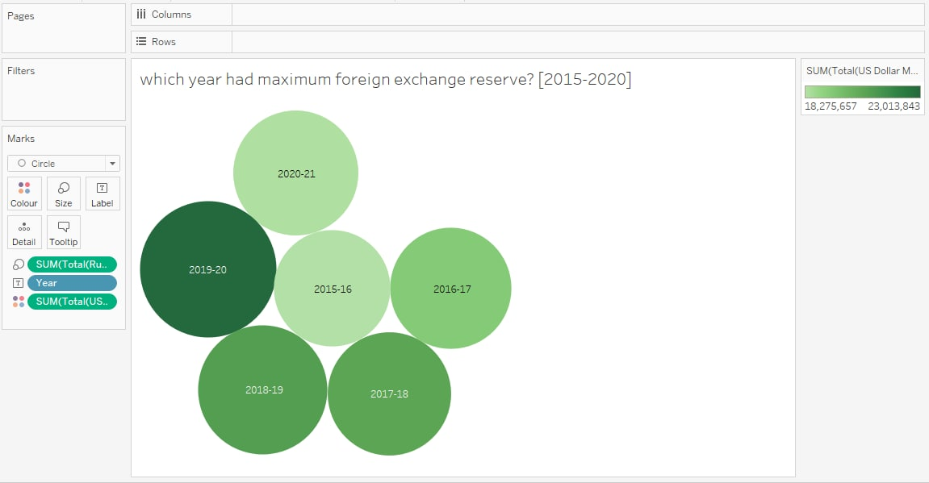

Slide 14
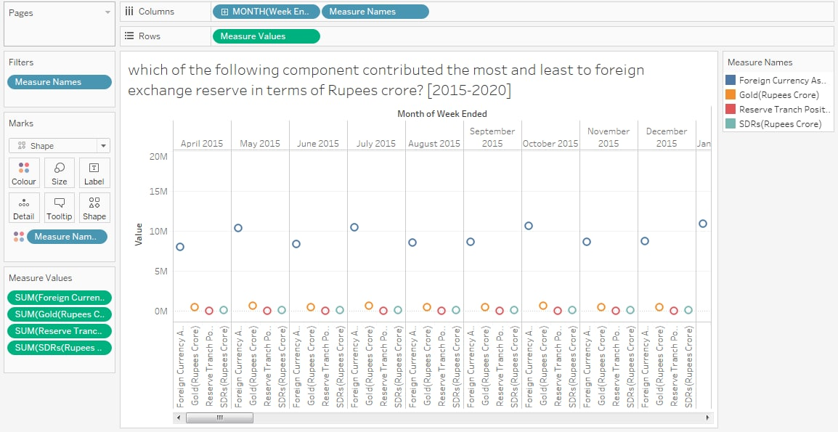

Slide 15
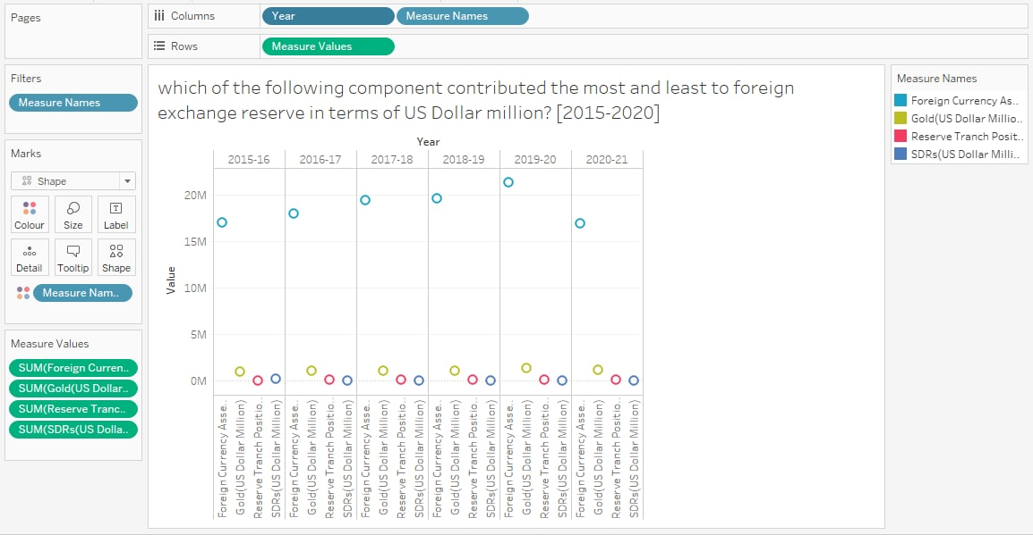

Slide 16
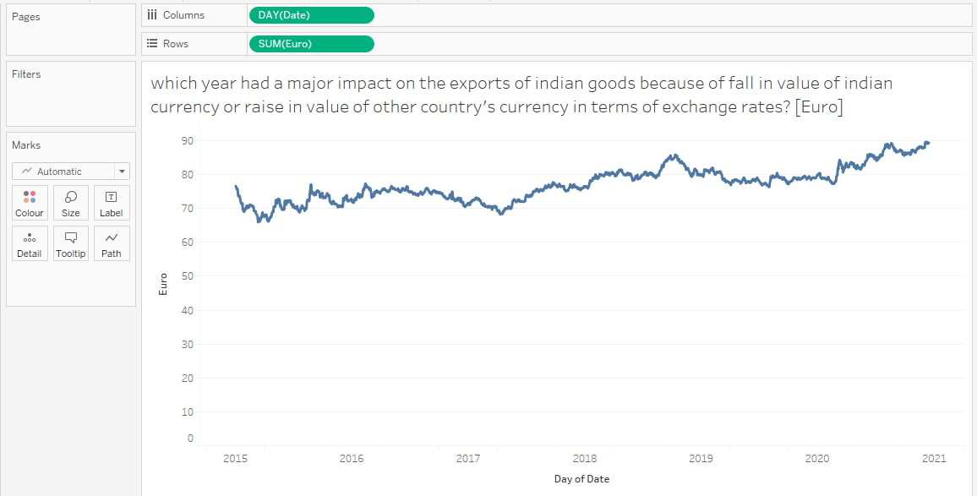

Slide 17
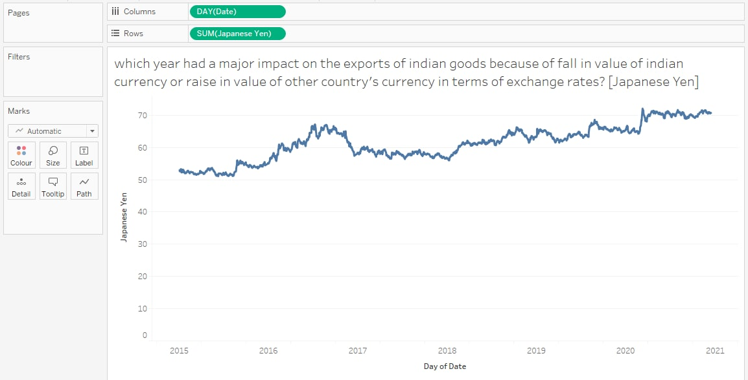

Slide 18
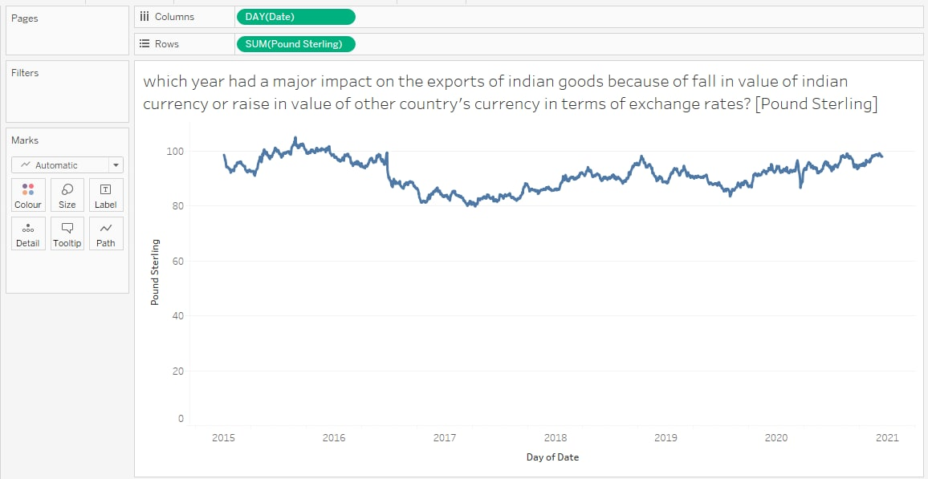

Slide 19
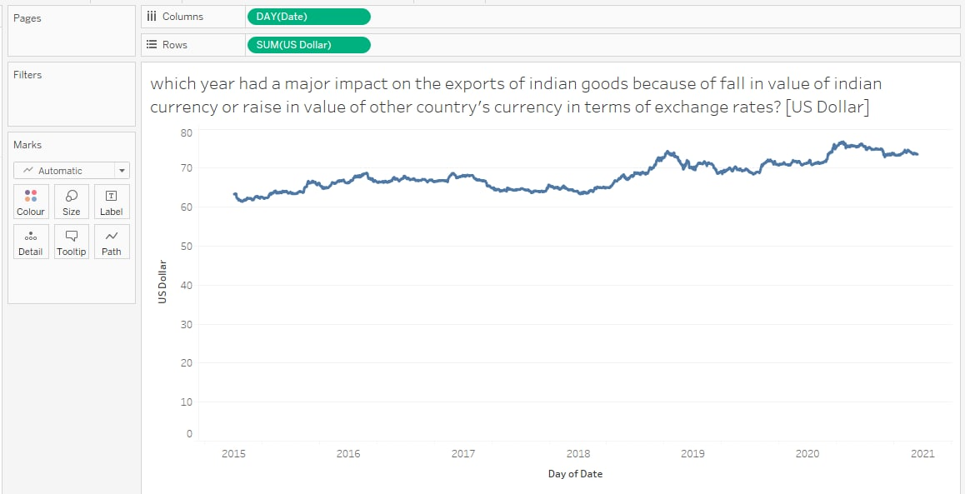

Slide 20
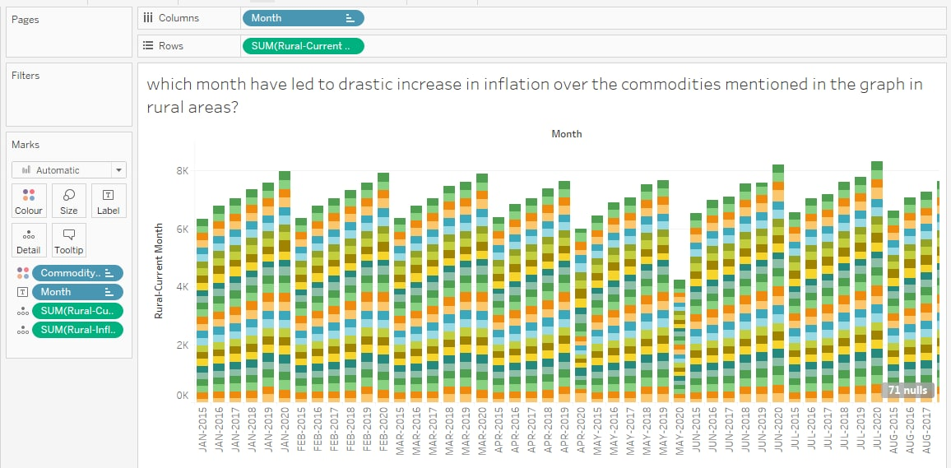

Slide 21
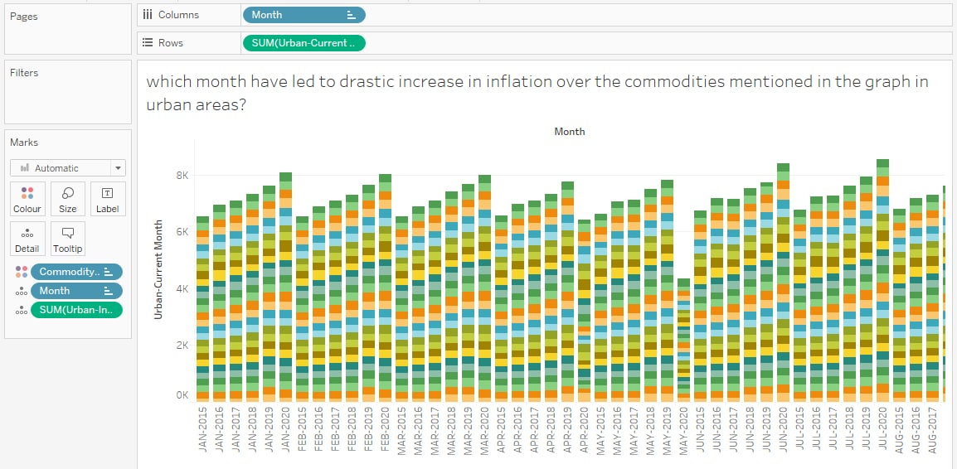

Slide 22
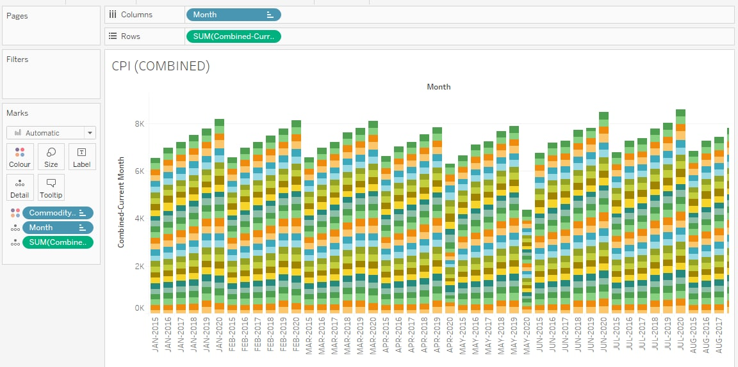

Slide 23
THANK YOU

